Slide 1
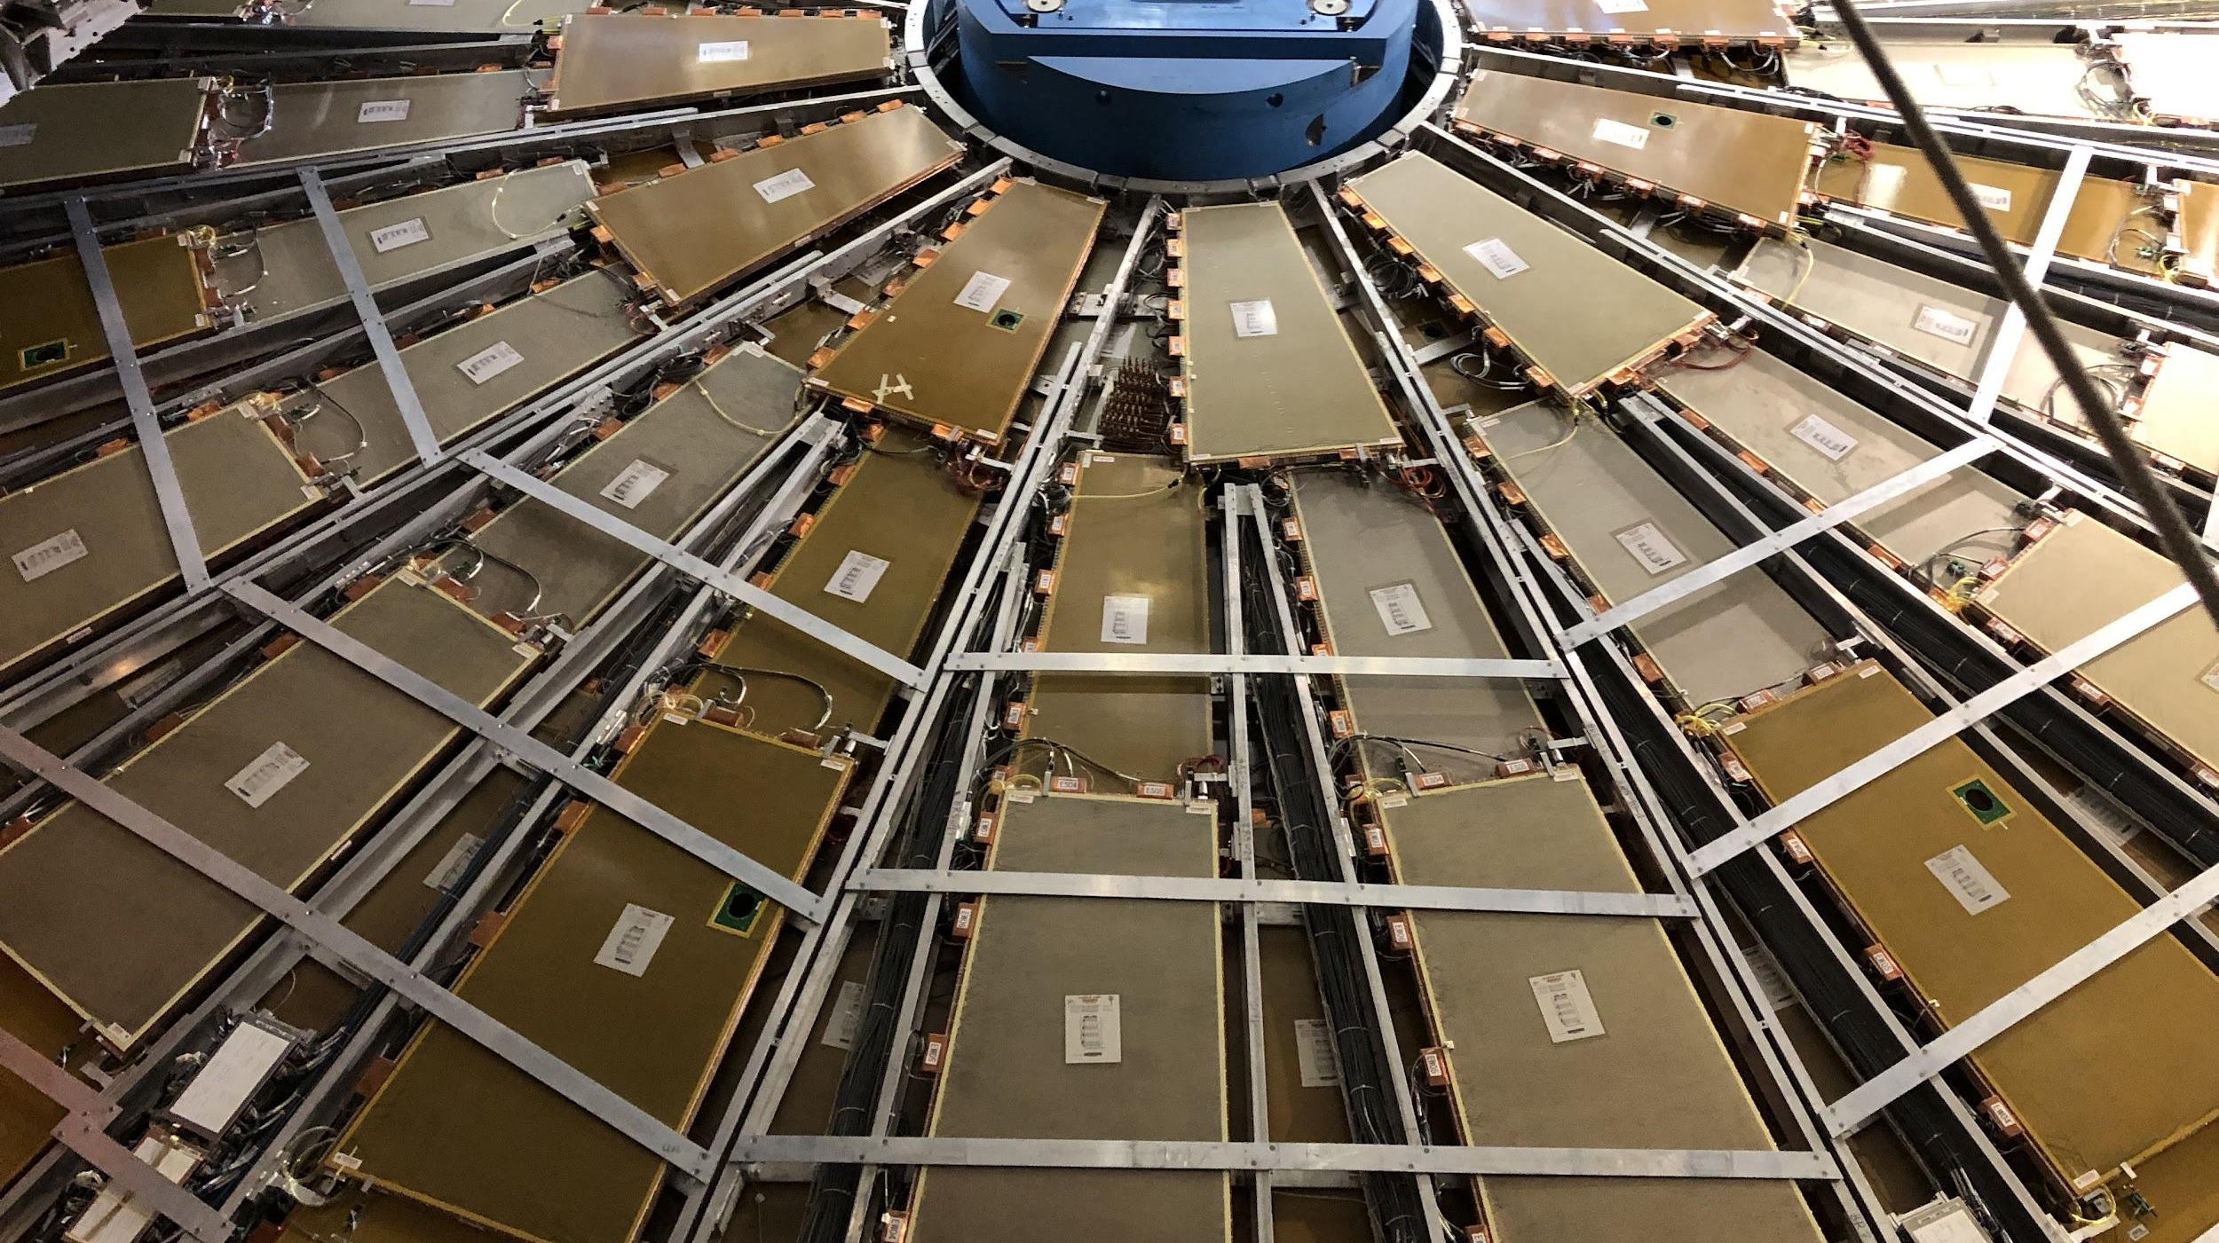


CIS Tech Update
Chicago Meeting, August 15th, 2022
Peter Camporeale and Jacky Li

Slide 2
Outline
CIS Constant Updates
June 23 - July 14
July 15 – August 9
Low Voltage Power Supply / Detector Control System Monitoring
L1 Trigger System
Fast Calo Simulation
Test Beam
ATLAS Control Room Shifts
Life

Slide 3
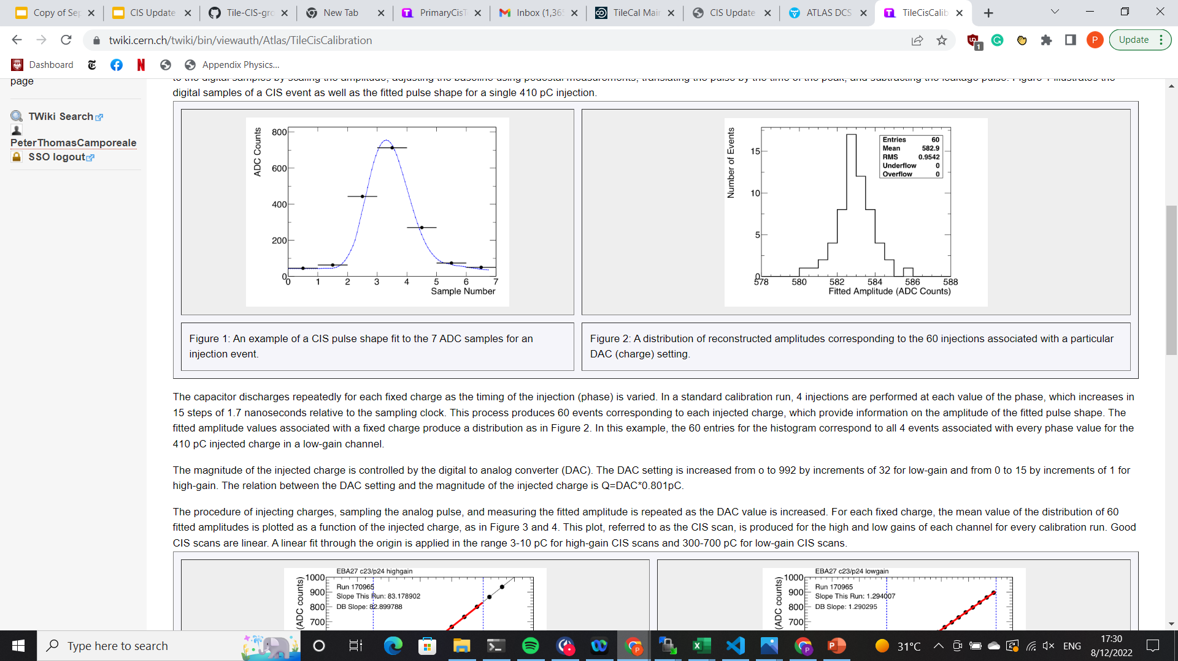
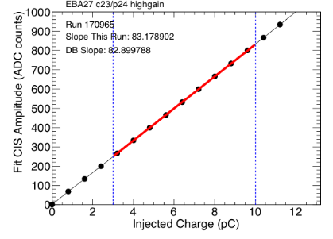
Summary of CIS
Use known input charge to calibrate ADC counts of front-end electronics
3-in-1 cards contain 5,100 pF capacitors
Input known charge 60 times, sample each pulse 7 times → pulse amplitude
Fit mean pulse amplitude (in ADC counts) to injected charge
CIS calibration runs are taken between ATLAS runs, roughly 3 times per week
Use TUCS to analyze data for recent runs and identify DQ issues in channels
Monitor individual channels: drifting, high scatter, half-gain?
Monitor overall performance: percent change, long-term stability, RMS/mean
Upload new constants to database

Slide 4
1.a. CIS Constant Update: June 23-July 14
Transition from last generation of Katie and Dawit to Peter and Jacky

Slide 5
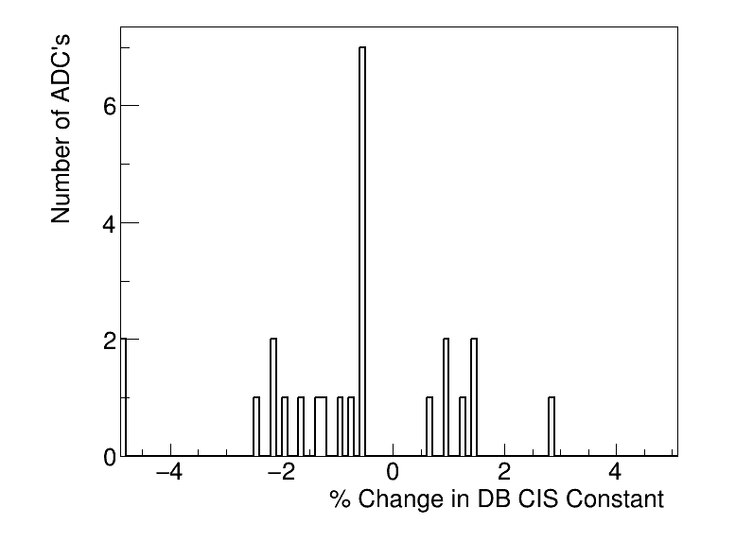
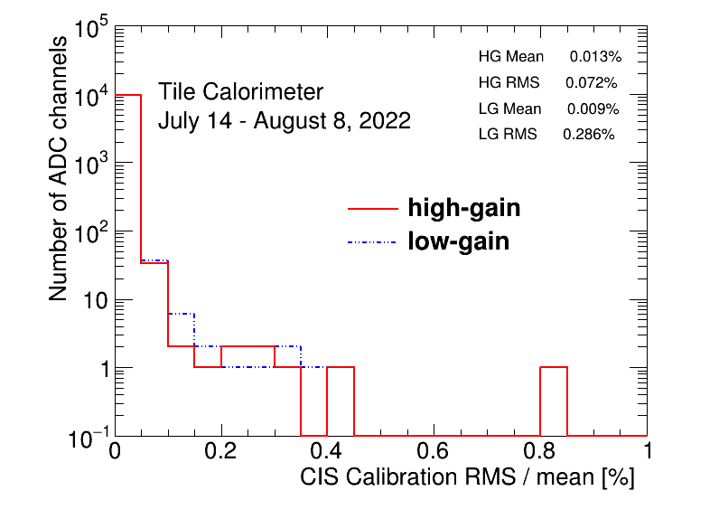
1.b. CIS Constant Update: July 14 – August 8
Independently done by Peter and Jacky
Instead of using Google Drive, we are using GIT to store everything
Presented last Thursday (Aug. 11), DB to be renewed today.

Slide 6
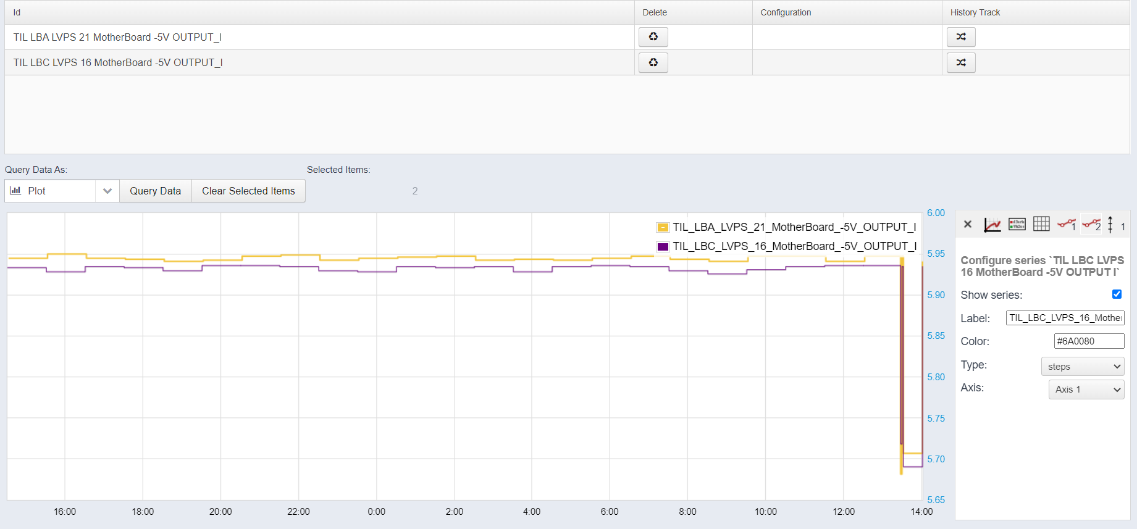
2. LVPS/DCS Monitoring
Overview:
Monitoring the current supplied to 5V motherboards in Tile modules
Currently, there is an online database. We want to collect this data to monitor current trips and integrate it with current systems
DDV applies “smoothing” to DCS: it only updates if the current change is outside a given interval
Online DDV data/plotting

Slide 7
2. LVPS/DCS Monitoring
Done:
Connected with Felipe Martins
Generated code for accessing/checking DCS values
Became familiar with some legacy code
Added new functionalities: time-averaging of current
To do:
Integrate the code into TIO (online monitoring system)
Connect with Sergei Chekalev

Slide 8
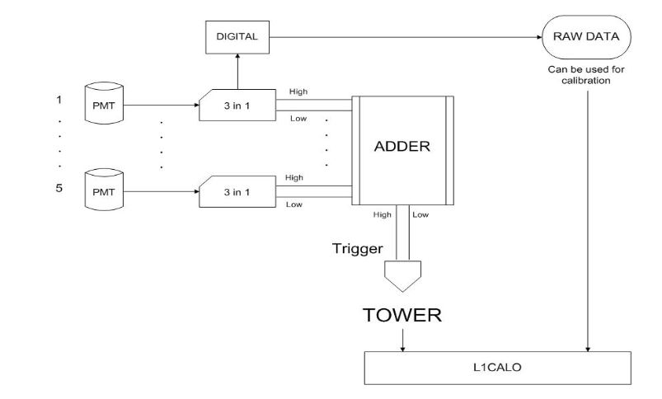

3. L1 Calo Trigger System
Connected with Danijela Bogavac
Overview of system:
Towers are collections of PMTs and front-end electronics that sum events covering $Δη×Δφ=0.1×0.1$ to produce trigger signals
Goals:
Monitoring of trigger rates in the L1 Calo
Integrate with Data Quality Monitoring Display (DQMD) in ACR
Analyze PMT scans to identify low trigger rates
Schematic of L1 calo tower

Slide 9
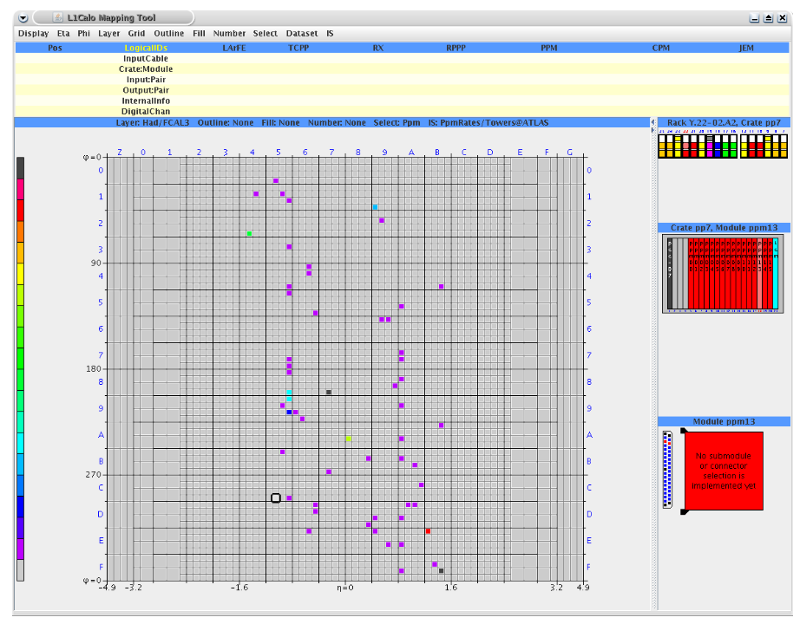
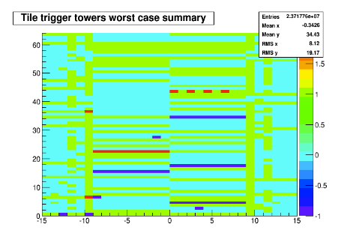
3. L1 Calo Trigger System
Done:
Reviewing code/documentation
Tour of ACR to see these systems in action
To do:
Meeting with Danijela again next week to commence project
Current L1 Calo Mapping Tool Data Quality Monitoring Display (DQMD)
Current L1 Calo Mapping Tool in Online Histogram Presenter (OHP)

Slide 10
4. Fast Calo Simulation (FCS)
Dawit explained his code and the goal of the simulations
Done:
Recreated plots
To do:
Connect with FCS group
None, until further notice.

Slide 11
5. Test Beam
Connected with Irakli Minashvili
Done:
Checked the legacy Tile system in Test Beam.
Fixed one Mobidick for its HV problem
To do:
Shift training before new test beam in November
None maintenance until further notice (Irakli is taking his vacation)

Slide 12
6. ATLAS Control Room Shifts
Peter’s first shifts were August 2 – August 8
Monitoring data quality for Tile modules
Reporting on LAr status and major problems
More shifts in late August and September
Jacky’s shift training is on August 24th-25th

Slide 13
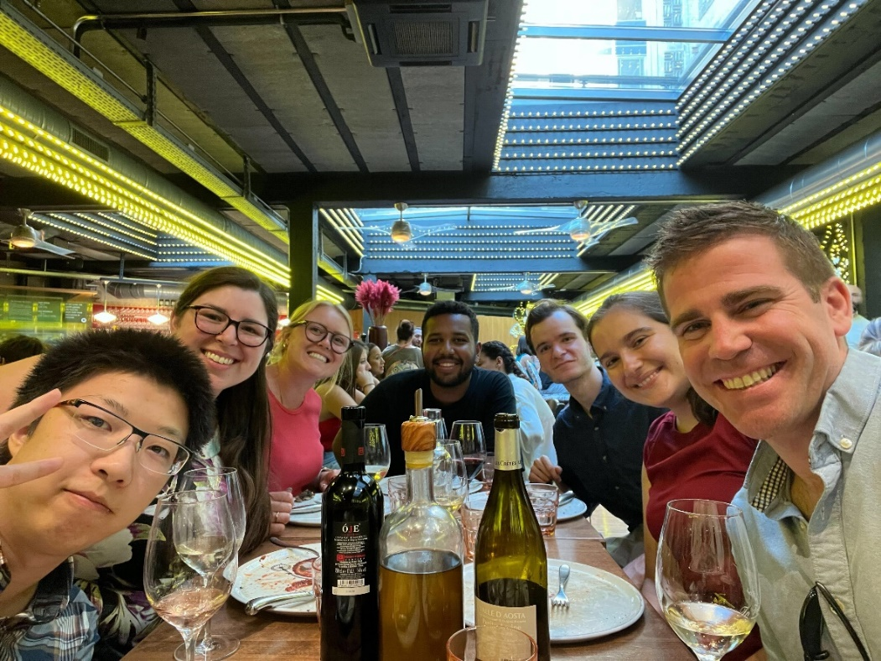
7. Life
Old CIS techs leaving
Katie left on July 25
Dawit left on August 13
Prof. David Miller’s visit late June
Getting settled in the city
Learning/refreshing driving manual
June 29th , Dinner at Luigi’s

Slide 14
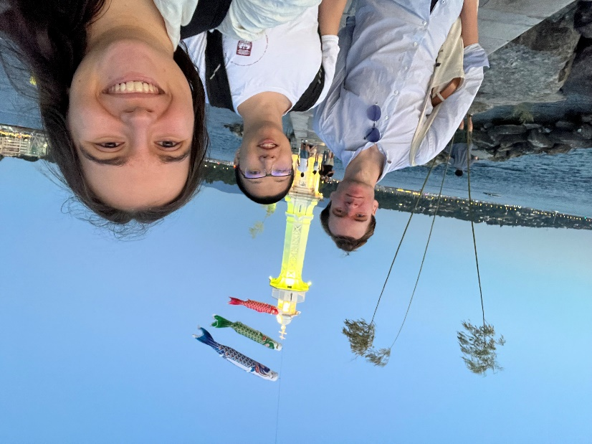
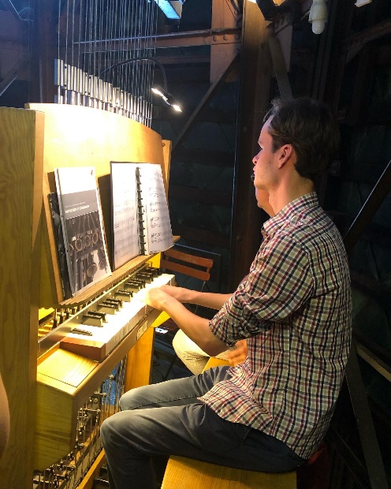
7. Life (More Pictures)
Jacky teaching Peter to drive manual
Peter playing the carillon at Cathedrale St.-Pierre
At Bains de Pâquis

Slide 15
8. Questions
Add questions here if we have any

Slide 16
Thank you for your attention ☺

